Slide 1
Certifications are Worth the Effort! Overview of Banner 9 Effort Certification System and Escalation Process for Delinquent Reports
Jeremy Hamlin, Jason Galloway, Jessica Armijo
Contract & Grant Accounting Main/HSC
Wednesday, September 29, 2021 (10:15 – 11:00am)

Slide 2
Agenda
Purpose of Effort Certifications
Navigating the Effort Certification Module (Banner 9)
Banner Authorization Request (BAR) Roles
Delinquent Reports and Escalation Process
Common Problems

Slide 3
Purpose of Effort Certifications
Jason Galloway, Associate Controller
Contract and Grant Accounting, HSC

Slide 4
Why do we Certify Effort?
Uniform Guidance Subpart E §200.430 contains the federal regulatory requirements for internal controls over certifying time expended on sponsored projects.
Effort certification is a way for the government and other sponsors to verify that salaries charged to a project are for work done on that project. Effort certification is required for every employee who receives a portion of his or her salary from a sponsored project or cost sharing account.
Only 5R employees have effort certified in the effort system.
2R employees are “certified” on their timesheets, and therefore, don’t require an effort certification.

Slide 5
Why do we Certify Effort? (Cont.)
When certifying effort, the PI is confirming that salaries and wages charged to a sponsored project in relation to the work performed and committed to the agency in the proposal are accurate.
UNM is required to assure that all salary charged on sponsor awards are fair, consistent and timely with the effort performed.
Expenditure disallowance – Salary is unsupported, and therefore, unallowable.
Non-compliance on the Uniform Guidance Single Audit – could impact future funding.

Slide 6
Navigating the Effort Certification Module
Jessica Armijo, Accounting Manager
Contract and Grant Accounting, Main Campus

Slide 7
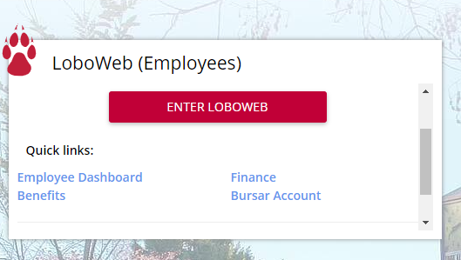
Accessing Reports
First log into MyUNM: https://my.unm.edu/home
Select the Employee Life tab - Click on the ‘ENTER LOBOWEB’ link.

Slide 8
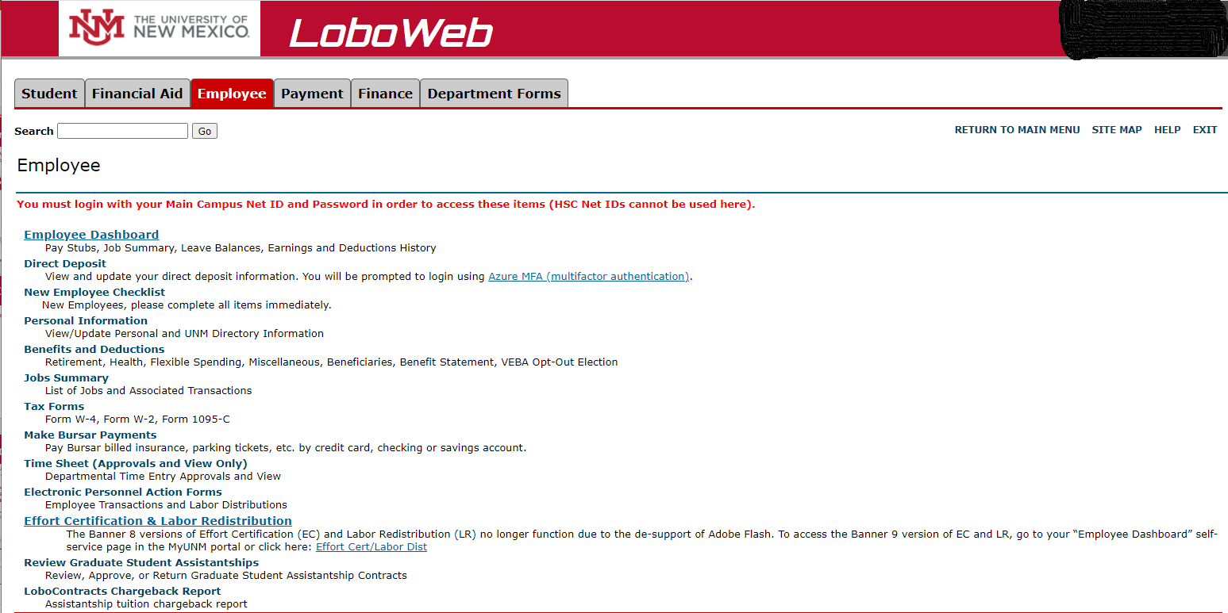
Select Effort Certification
On the Employee Tab in LoboWeb select ‘Effort Certification & Labor Redistribution’ link.

Slide 9
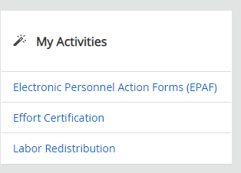
Select Effort Certification cont.
In the Employee Dashboard go to the My Activities box on the right side of the page select the ‘Effort Certification’ link.

Slide 10
How to Certify Your Own Effort
System will default to the ‘Certify My Effort’ tab where PI information will be displayed. This is where you will certify your own effort. Double click on your effort to open it.
To view all other employee Effort Reports requiring certification, click on the Review or Certify Reports tab and complete the steps below before accessing the list effort reports requiring certification.

Slide 11
Certifying Effort for all other employees on an award (5R Salaried employees only).

Slide 12
Step 1 – Select Review or Certify Report
To view all the employee Effort Reports that need to be certified select ‘Review Or Certify Reports’ tab at the top of the page.

Slide 13
Step 2 – Click Advance Search
Advanced Search should come up automatically but if it does not click Advance Search to view search options.

Slide 14
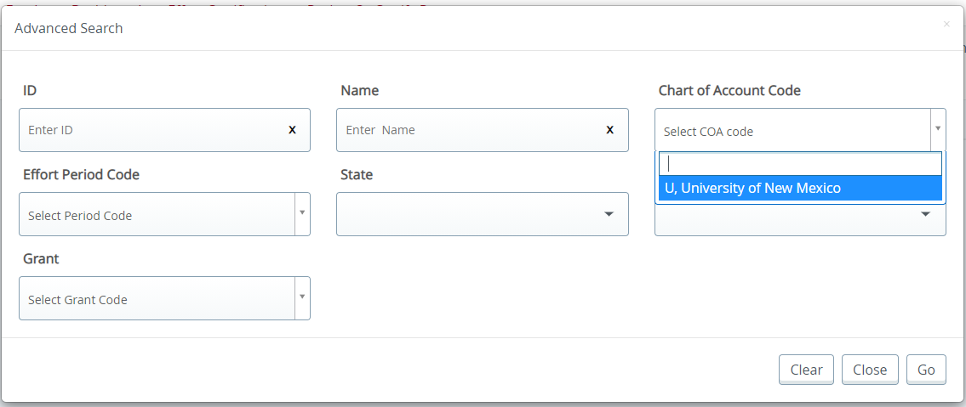
Step 3 – Select Chart of Account Code
Select the drop down for the Chart of Account Code and click U, University of New Mexico

Slide 15
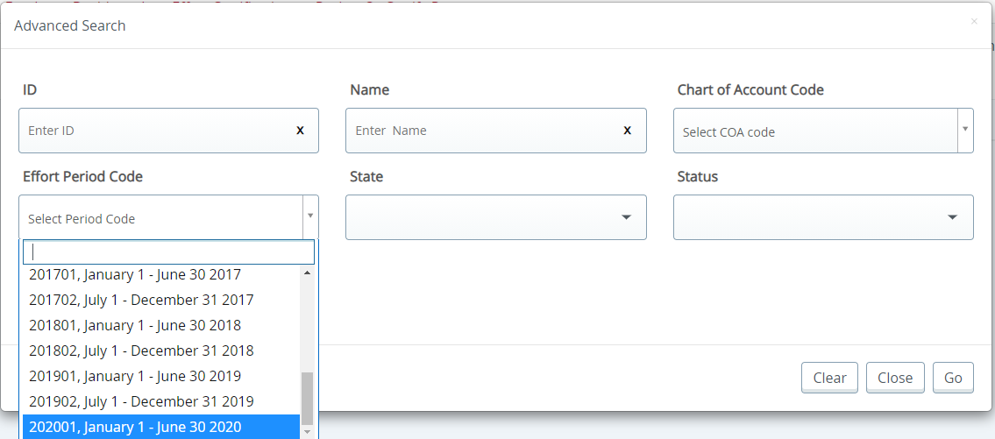
Step 4 – Select Effort Period Code
Important Note: The current effort period will be at the bottom of the list.
Select the effort period, and then click ‘Go’ on the bottom right of the screen to display all the effort reports that need to be certified.
Select the drop down for the Effort Period Code and click 202001, January 1 – June 30 2020

Slide 16
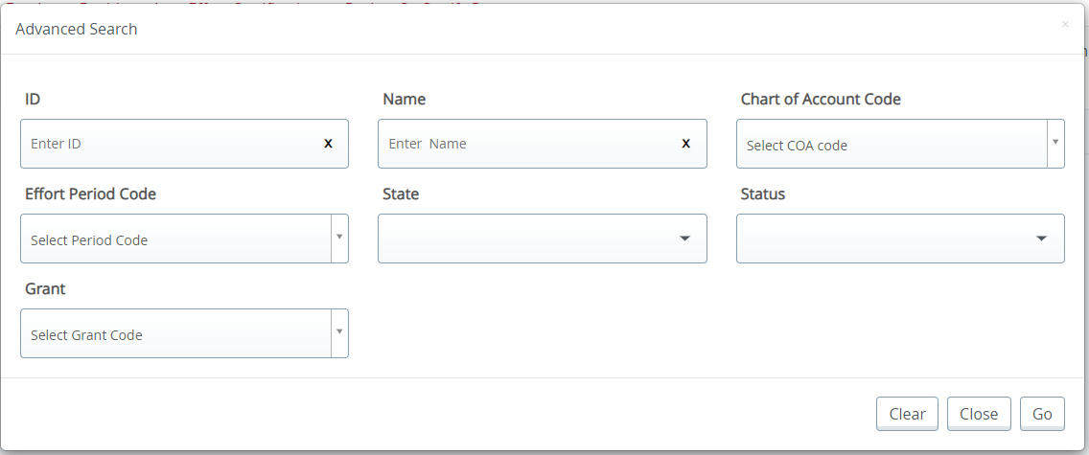
Step 5 – Search for Reports to Review
NOTE: If you know the Banner ID you can just search by that as well
Enter the Employee Banner ID in the ID box then click Go

Slide 17
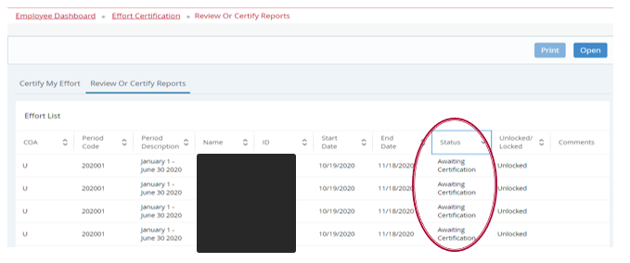
Step 6 – Select from Employee List
Double click on the record to view effort report actions
Note: Status and State of each employee

Slide 18
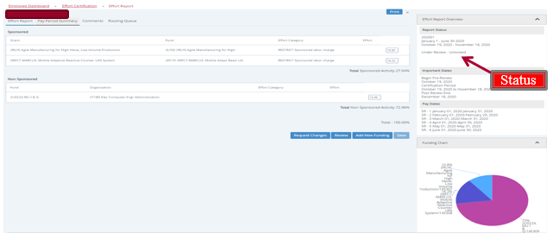
Employee Effort Report
Salary distribution is displayed as a percentage; a pie chart also displays the salary distribution
Tolerance of +/- 5% is acceptable from original award vs. effort worked – If there is a discrepancy email maineffortrptng@unm.edu or HSC-Effort-Reporting@salud.unm.edu

Slide 19
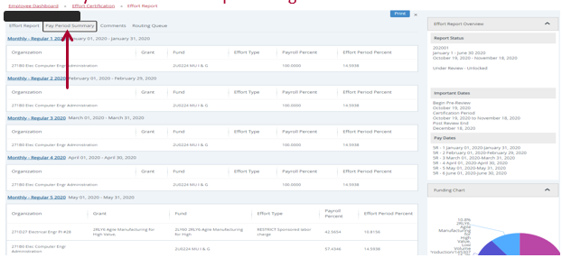
Pay Period Summary
Click on Pay Period Summary to view effort by pay period
If grant is not active over entire 6-month effort certification period, this is where you can view detail by month to ensure percentages are accurate

Slide 20
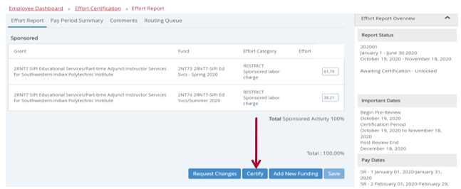
Final Step – Certification
Select ‘Certify’ Button
Complete certification process by accepting certification statement in pop-up window
NOTE: Certification will not be completed until all Fund Financial Manager have certified.

Slide 21
Banner Authorization Request (BAR) Roles

Slide 22
BAR Roles Required for Access
BAR Roles are now required to certify efforts
Online Training thru Learning Central:
EOD 931 – Effort Certification Training for Certifiers (PI’s)
BAR Role:
“Department Effort Certification Reviewer”

Slide 23
Delinquent Process
Jeremy Hamlin & Jason Galloway

Slide 24
Process for Delinquent Certifiers (Main/Branch Campus)
NOTE: System generated delinquent emails should start on Mondays and Wednesdays immediately after the certification deadline has passed. (PI and Chairs)
First follow up: (2 weeks after certification due date): One mass email to be sent to all delinquent Main Campus certifiers (only PI’s in awaiting certification status).
Second follow up (30 days after certification due date): Email sent directly to the PI and cc: the Account Admin (Pre-Reviewer).
Third follow up (60 days after certification due date): Email sent directly to the PI and cc: the Account Admin & Dean/Chair.
Fourth follow up (90 days after certification due date): Non-compliance email sent with consequences outlined (moving salary charges to OE index) for failure to certify directly to the PI and cc: the Account Admin, Dean/Chair, and ADR/Center Director.
Fifth follow up email (2 weeks later): Email directly from Associate Controller with final deadline to certify (1 week given) before charges are moved off of award. Email will be to the PI, Dean/Chair, ADR/Center Director, and AVPR.

Slide 25
Process for Delinquent Certifiers (HSC Campus)
System generated delinquent emails we start on Mondays and Wednesdays immediately after the certification deadline has passed. (PI and Chairs)
Certifications that are 30 days delinquent Department Administrators (DA) and PIs will be contacted manually by HSC C&G Office.
Certifications that are 60 days delinquent, with no response from department on previous email - DA, PI, Chair and Dean will be contacted manually by HSC C&G Office.
Certifications that are 90 days delinquent, with no response from department on previous email - HSC C&G Office will notify the Compliance Office with the PI’s failure to certify.

Slide 26
Common Problems
Jeremy Hamlin, Associate Controller
Contract and Grant Accounting, Main Campus

Slide 27
Employee Tab in LoboWeb
Don’t see the Effort Certification & Labor Redistribution
Need to get the effort certification BAR role in order to have access to the system

Slide 28
Only see personal effort
Don’t see the list of employees to certify
Have to click on ‘Review or Certify Reports’ tab and search for the effort period to access the list of employees to certify.

Slide 29
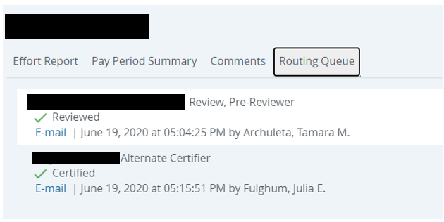
Verifying that the effort is certified
Check routing queue: Certified
Check status: Completed

Slide 30
Contact Information
Contact your pre-reviewer or departmental grant administrator for general/procedural questions
For all other questions, contact applicable Contract & Grant Accounting office
Contract & Grant Accounting - Main Campus/Branches
277-4721
Contract & Grant Accounting - Health Sciences Center
272-0163
Or send Email to:
Main Campus – maineffortrptng@unm.edu
HSC Campus – HSC-Effort-Reporting@salud.unm.edu

Slide 31
Contract & Grant Website
Has helpful information for effort.
Contains Quick Guide for Certifiers
http://cgacct.unm.edu/effort-certification.html

Slide 32
QUESTIONS

